Slide 1
Introduction of Recurrent Neural Network
Yifei Huang
2017-07-03

Slide 2
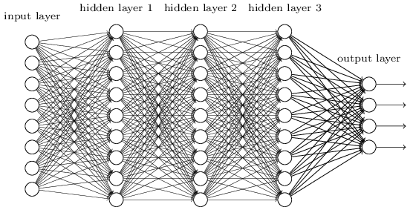
NN

Slide 3
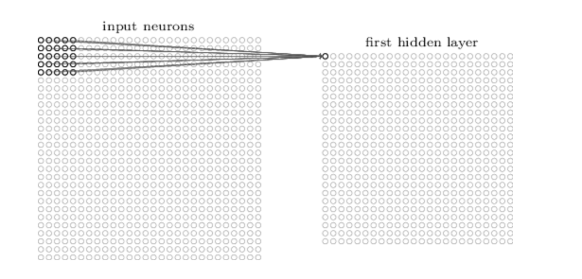
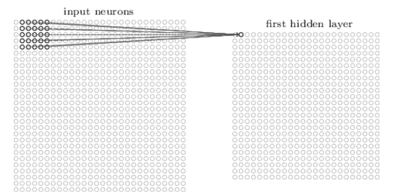

CNN

Slide 4
But sometimes,
E
L
L
O? L?
<END>
H
E
L
L
O

Slide 5
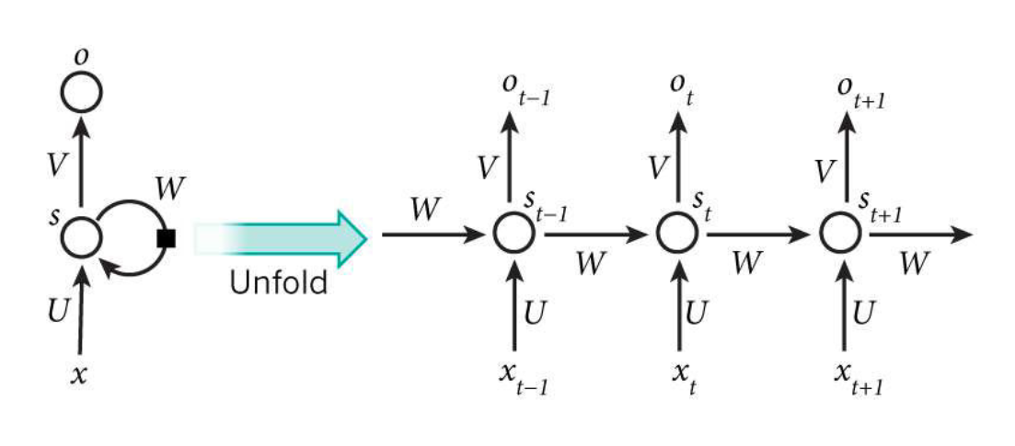
RNN

Slide 6
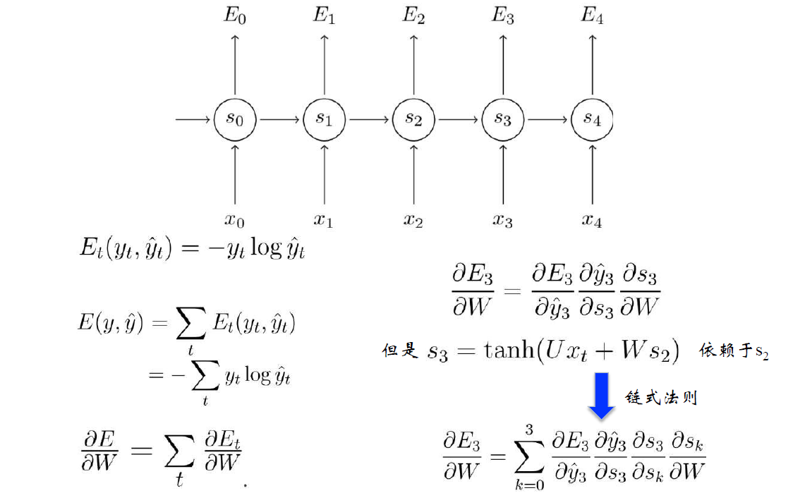
BPTT

Slide 7
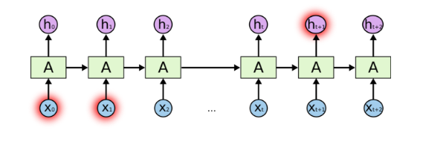
The problem

Slide 8
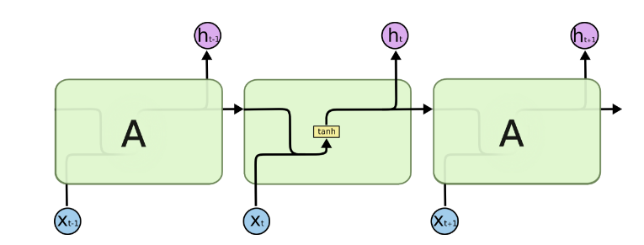

Slide 9
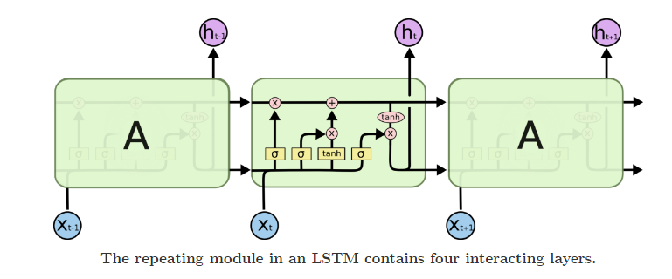

LSTM (Long-Short-Term-Memory)

Slide 10
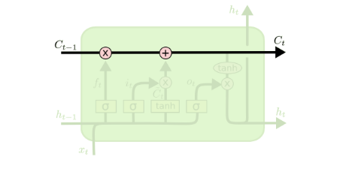
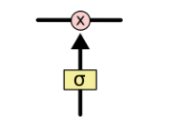

Slide 11


Slide 12


Slide 13


Slide 14


Slide 15

GRU

Slide 16
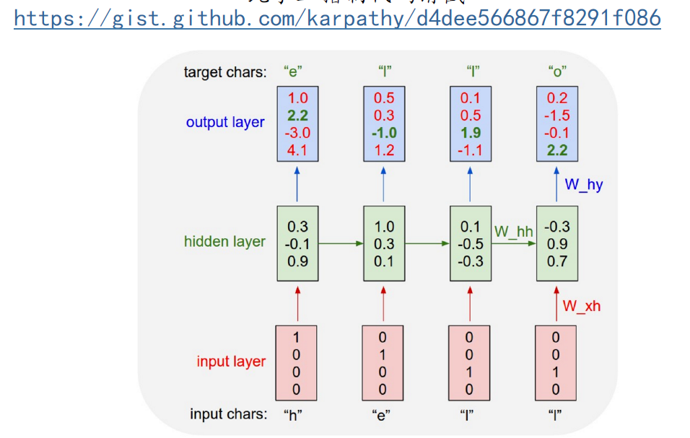
Char-RNN

Slide 17
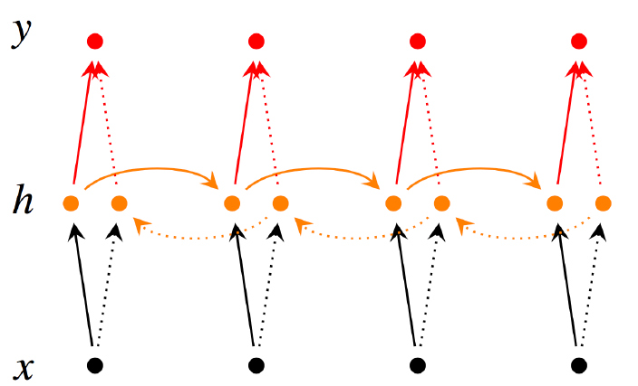
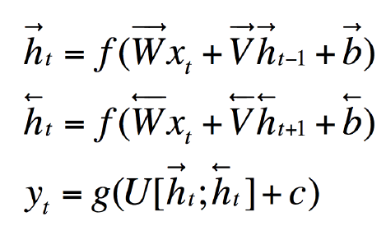

Slide 18
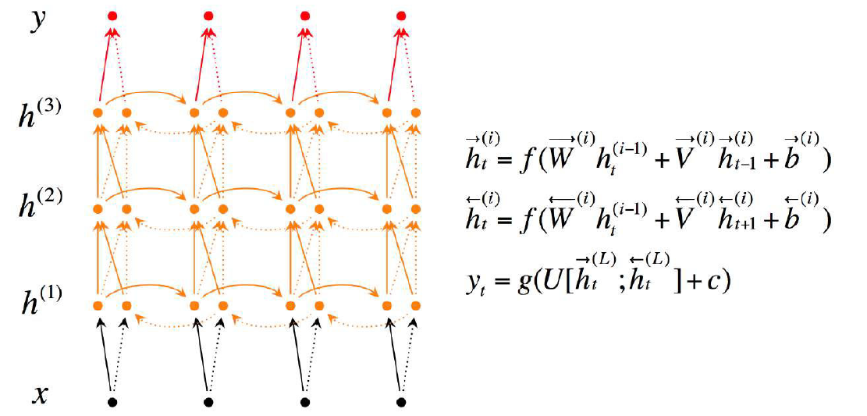

Slide 19
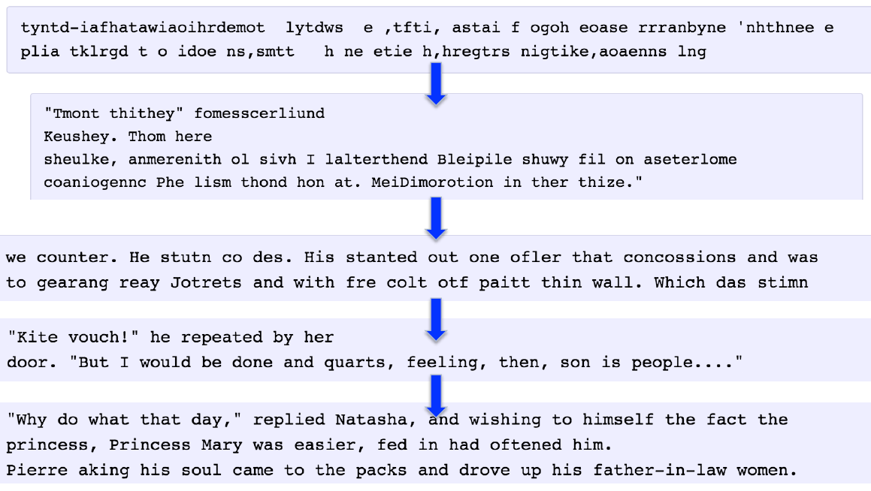
Example

Slide 20
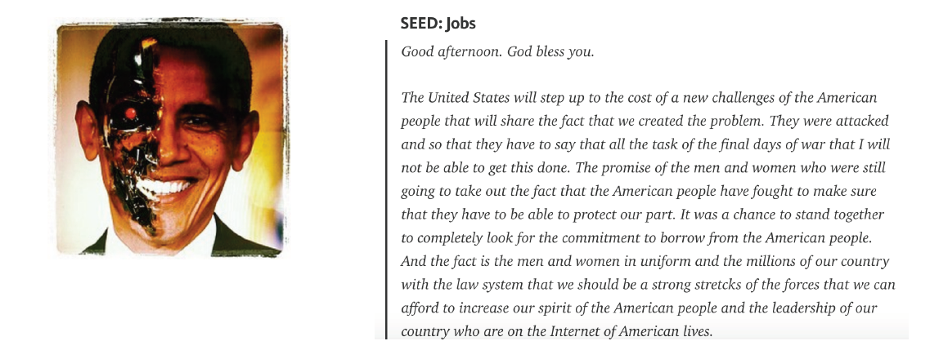
Example:

Slide 21
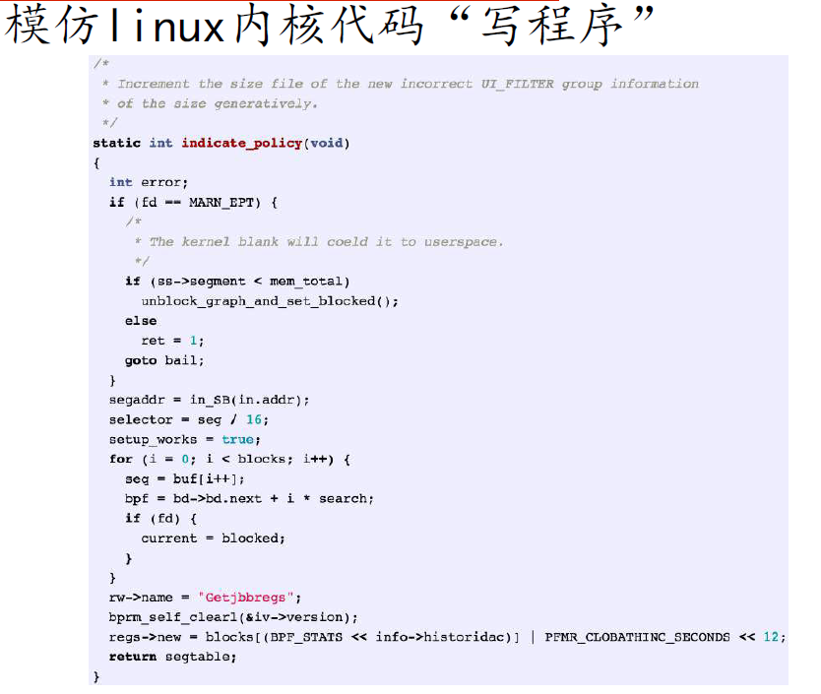

Slide 22
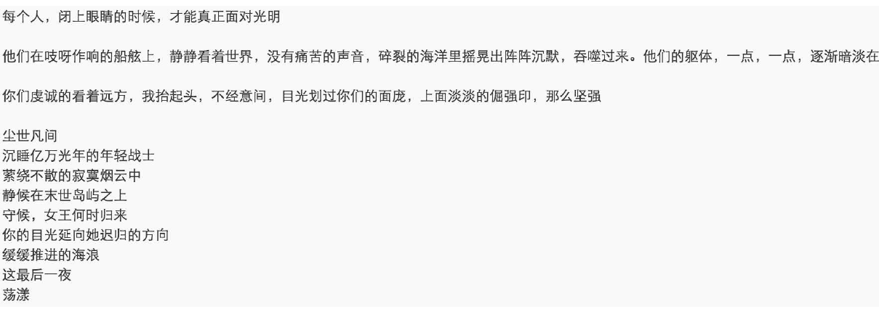

Slide 23
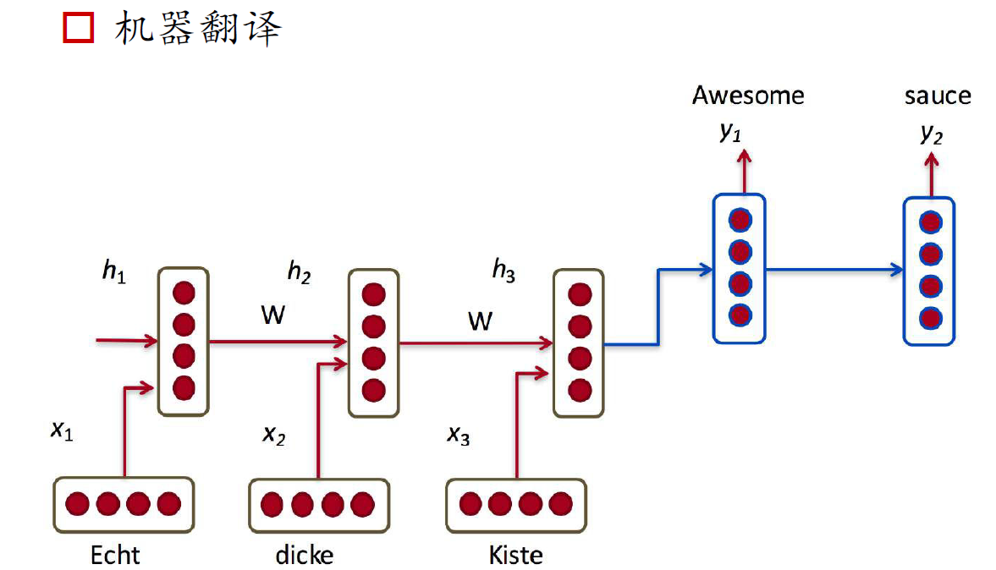

Slide 24
Ref
http://colah.github.io/posts/2015-08-Understanding-LSTMs/
http://www.deeplearningbook.org/contents/rnn.html

